Slide 1

LOOP

Slide 2
INTRODUCTION

Slide 3
What is loop?
“A loop is a block of code that is continually repeated until a certain condition is reached.”

Slide 4
Problem-1: print “ha ha ha” 1000 times.
pritnf(“ha ha ha\n”);
pritnf(“ha ha ha\n”);
pritnf(“ha ha ha\n”);
pritnf(“ha ha ha\n”);
pritnf(“ha ha ha\n”);
pritnf(“ha ha ha\n”);
.
.
.

Slide 5
Problem-1: print “ha ha ha” 1000 times.
for(i = 1; i <= 1000; i++)
{ printf(“ha ha ha\n): }

Slide 6
Problem-2: Print the sum of all numbers between 1 to 1000.
int sum = 0; int i; for(i = 1; i <= 1000; i++) { sum = sum + i; } printf("%d\n", sum); return 0;
Output: 500500

Slide 7
Types of Loop.
While Loop
For Loop
Do-While Loop

Slide 8
BASIC CONCEPTS OF LOOP

Slide 9
Initialization, condition, increamentation/decreamentation
→ Syntex:
for(initialization expression; loop repeatation condition;
update expression){
statement;
}
example:
for(i = 0; i < 5; i++){
printf(“Hey! Good afternoon students.\n”);
}

Slide 10
Interpretation:
First the “initialization expression” wiil be If executed
Here in our program “i = 0” is the initialization part.
Then “loop repeatation condition” will be tested.
Here it is “printf(“Hey! Good afternoon students.\n”);”
If it is true…then the “update expression” will be executed
and it is “i++”….and so on.
for this loop our program will show result following…
Hey! Good afternoon students.
Hey! Good afternoon students.
Hey! Good afternoon students.
Hey! Good afternoon students.
Hey! Good afternoon students.

Slide 11
FOR LOOP

Slide 12
Syntax :
The syntax of a for loop in C is
for( initializer ; condition; increment)
{
statement(s) ;
}

Slide 13
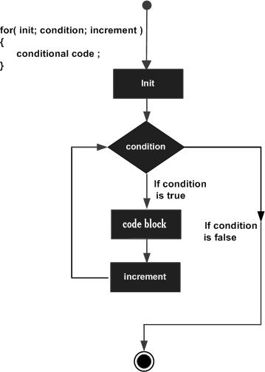
Flow Diagram

Slide 14
Example:
#include<stdio.h>
#include<stdlib.h>
int main()
{
int i;
for(i=0; i<=10; i++)
{
printf(“%d/n”, i);
}
return 0;
}

Slide 15
Output:
When the above code is complied and executed, it produces the following result:
value of i: 1
value of i: 2
value of i: 3
value of i: 4
value of i: 5
value of i: 6
value of i: 7
value of i: 8
value of i: 9
value of i: 10

Slide 16
WHILE LOOP

Slide 17
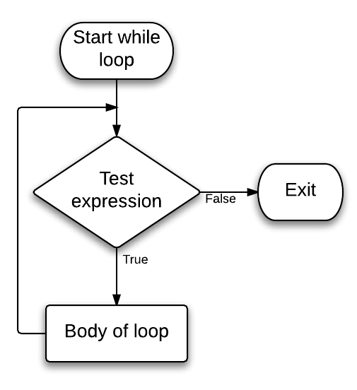
While loop syntax:
initialization;
While(condition)
{
-------------------
-------------------
-----------------
Incrementation;
}

Slide 18
While loop syntax:
For Single Line of Code – opening & closing braces are not needed.
While(1) is used for infinite Loop.
Initialization, Condition & Incrementation steps are on different line.
While Loop is also Entry Controlled Loop.

Slide 19
Example:
int i=0;
while(i<3)
{
printf(“Hello World!”\n);
i++;
}
Output:Hello World!
Hello World!
Hello World!

Slide 20
DO-WHILE LOOP

Slide 21
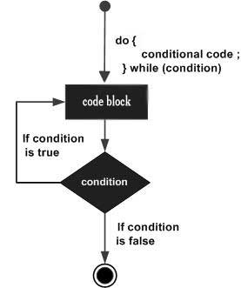
Do While Loop
1. Almost smiler to “while” loop
2. Runs a block minimum once
3. Checks condition after running block
4. Like other loops, if condition is not true, the loop terminates.

Slide 22
Do-While Loop: Example
#include <stdio.h>
int main()
{
double number, sum = 0;
do
{
printf("Enter a number: ");
scanf("%lf", &number);
sum += number;
}
while(number != 0.0);
printf("Sum = %.2lf",sum);
return 0;
}

Slide 23
CONCLUSION

Slide 24


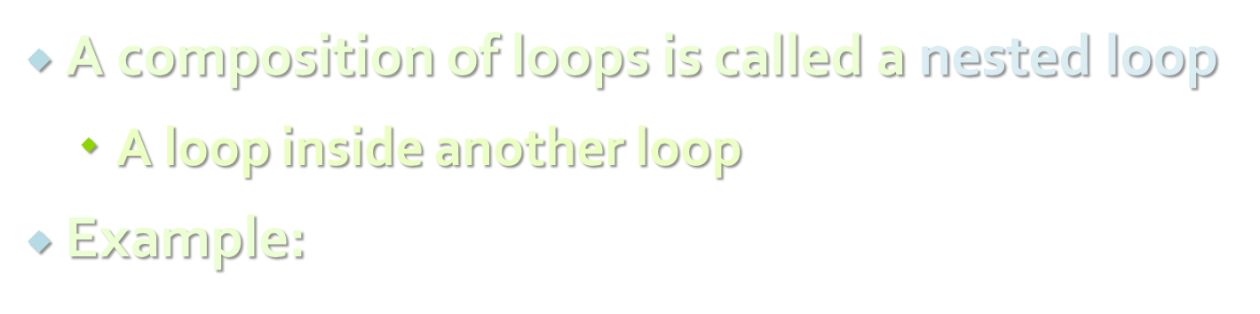
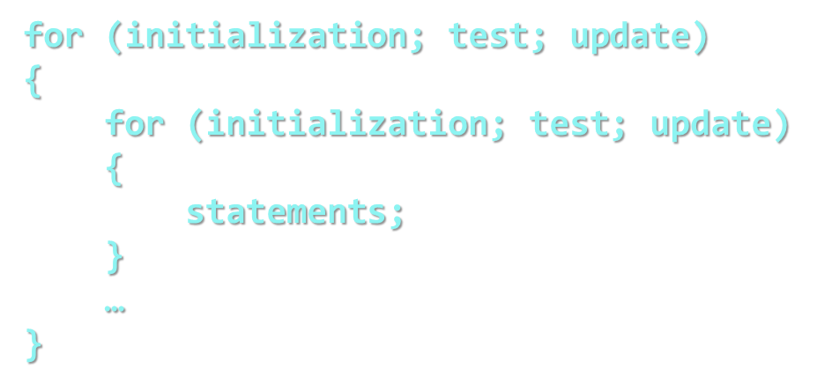
NESTED LOOPS: USING LOOP INSIDE LOOP

Slide 25


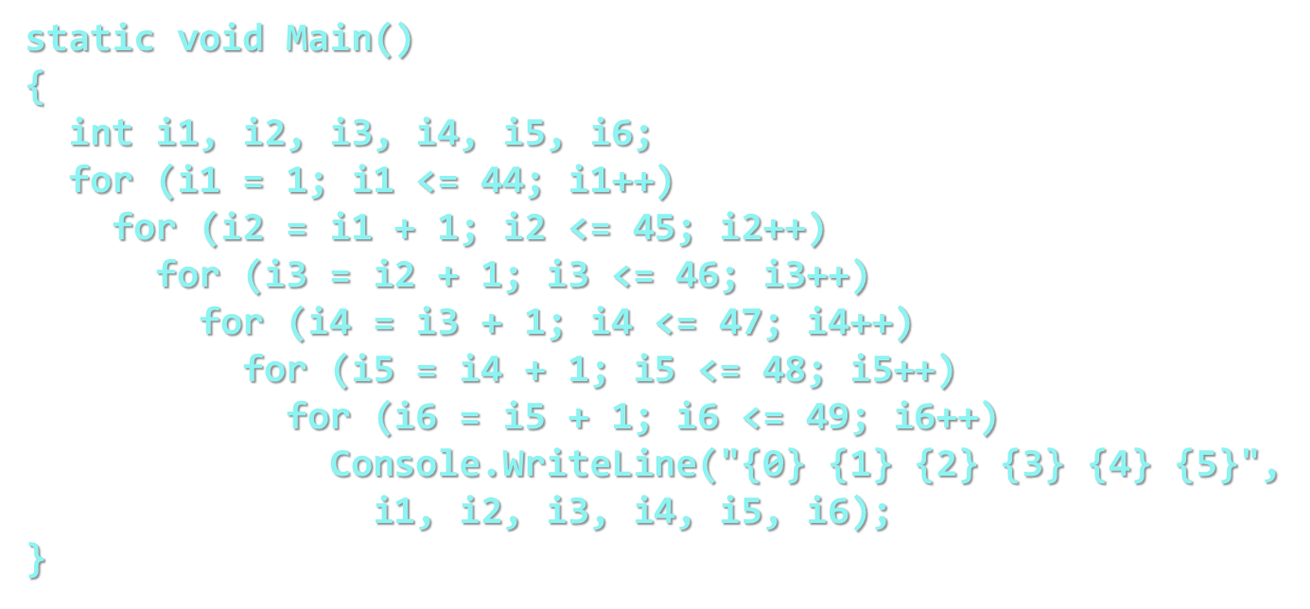



Slide 26

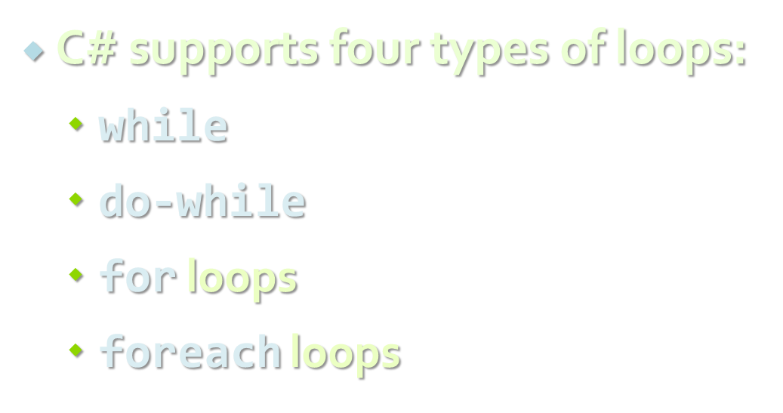
SUMMARY

Slide 27
Thanks!

